Slide 1
Introduction to APIs
by BPI

Slide 2
Introduction to APIs
What You’ll Learn
What is an API and RESTful APIs
HTTP
JSON and Serialization w/ Jackson
Building a REST API

Slide 3
Introduction to APIs
What We’ll Discuss
Definition of API
Short history of APIs
RESTful APIs and HTTP

Slide 4
Introduction to APIs
What is an API
“An API, or application programming interface, is a set of rules or protocols that enables software applications to communicate with each other to exchange data, features and functionality” -- Michael Goodwin, Staff Editor, IBM Think
API stands for Application Programming Interface
API is a general concept that provides a standard or a list of functionalities that other applications can implement, allowing it to communicate with that system
The processes behind the API are abstracted and the only concern of the connecting application is the data the API produces.
API is a type of interface

Slide 5
Introduction to APIs
Examples of APIs
Google Maps API allows applications to access Google Maps data such as (but not limited to) Geolocation data, Weather Data, and Road Data
InstaPay API allows different Online Banking applications to send payments to other banking accounts
OpenAI API allows applications to communicate with their AI models, providing a way for applications to integrate AI functionalities without needing resources that would otherwise be needed if they developed their own

Slide 6
Introduction to APIs
Example (Analogy)
You can compare the idea of an API with a typical restaurant visit
In a restaurant:
You go in and be seated
The server hands you a menu to order from
You tell your order to the server and the server writes it down
The server brings your order to the kitchen
The kitchen prepares your meal
The servers bring your food to your table
In this scenario, you go into the restaurant wanting to eat a dish that you ordered, and the server communicates this order to the kitchen. The customer is not concerned with how the kitchen prepares the dish.

Slide 7
Introduction to APIs
Short History of APIs
1940s, some suggest that the idea of an API was “invented” by computer scientists Maurice Wilkes and David Wheeler, wherein they worked on a modular software library for early computers and subsequently published a book that is considered to be one of the first published API specifications.
1960s, the first recorded use of the term “Application Programming Interface” in a paper by Ira W. Cotton and Frank S. Greatorex, Jr wherein they describe the term as the interaction of the application to the computer system. Their goal was to make hardware-independent software.
2000s, Roy Fielding published a dissertation paper on the concept of REST (Representational State Transfer) and RESTful APIs. A stateless and scalable architectural design for systems.

Slide 8
Introduction to APIs
RESTful APIs
RESTful API is an API that adheres to the principles/constraints of REST or REpresentational State Transfer.
REST is not a framework nor a library; It is an architectural style adapting 6 specific constraints. It was derived from how HTTP/1.1 worked.
Aside from the 6 constraints, the idea of RESTful APIs centers around the concept of “Resources” or the equivalent of entities/objects/concepts that you need to access.
RESTful APIs return a representation of a resource. Clients do not have direct access to the entity, and the process of how the resources are returned is abstracted from the client. Resources are typically nouns identified by the URI (Universal Resource Identifier). ex. /students, /loans, /users
HTTP methods on the other hand represent intent with regards to the resource. These are represented by verbs such as GET, POST, PUT, DELETE. You can think of these as actions that are performed on the URI.

Slide 9
Introduction to APIs
REST Constraints & Principles
Client-Server Architecture
Stateless
Caching / Cacheable / Cache
Uniform Interface
Layered System
Code-on-Demand

Slide 10
Introduction to APIs
Client-Server Architecture
The client (UI) is separate from the server (backend). Allowing each of them to scale independently.

Slide 11
Introduction to APIs
Stateless
Requests from the client that are sent to the server contain the required information to access it and the information is not stored in the server.

Slide 12
Introduction to APIs
Caching / Cacheable / Cache
The data within a response must be implicitly or explicitly labeled as cacheable or non-cacheable. Cacheable data can be reused for requests that are repetitive.

Slide 13
Introduction to APIs
Uniform Interface
Resources must be identifiable via URIs.
Resources must be represented in JSON or XML
Usage of HTTP so messages are self-descriptive
Hypermedia as the Engine of Application State (HATEOAS) wherein the server dynamically provides the client information on its next actions by including available URIs based on the state of the represented resource.

Slide 14
Introduction to APIs
Layered System
Allows a system to be composed of multiple independent layers where each layer can perform processing on the request / response such as load balancing or request validations. Clients are usually unaware of these layers.

Slide 15
Introduction to APIs
Code-on-Demand
An optional constraint that says a server may return executable code such as compile java scripts to the client as long as the client knows how to execute the code.

Slide 16
Introduction to APIs
On REST Principles & Constraints
Most APIs partially adhere to the constraints and it is important to note that there are very few APIs that implement full REST. Which is why most APIs today are accurately described as REST-like. (Read RMM or the Richardson Maturity Model)
In practice, a RESTful API will usually pertain to an API that:
Has resource-based URLs
Properly uses HTTP methods and returns correct HTTP Status codes
Uses Stateless requests
Primarily uses JSON representation
What’s not RESTful:
Verbs in URIs. ex: /getStudent, /deleteUser,
Lazy or incorrect usage of HTTP Methods
Excessive use of status 200 or improper use of other HTTP statuses

Slide 17
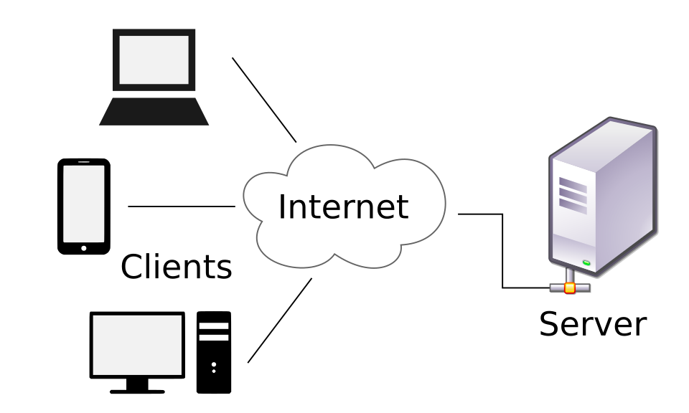
Introduction to APIs
Client - Server Architecture
A messaging pattern describing the concept of “Clients” (laptops, smartphones, browsers) that request data from “Servers” (any computer system that provides a resource or a service) over a distributed network
Client - requests services or data
Server - processes the request and returns a response
HTTP is the standard on how these two components interact
taken from https://en.wikipedia.org/wiki/Client%E2%80%93server_model#/media/File:Client-server-model.svg

Slide 18
Introduction to APIs
HTTP
HTTP stands for Hypertext Transfer Protocol
An application layer protocol for designing how applications exchange data and documents over the web via the TCP/IP model. (Other layers include the Transport Layer, Internet Layer, and the Link/Network Layer).
HTTP defines two kinds of messages, an HTTP Request and an HTTP Response
An HTTP Request is composed of the URL (Universal Resource Locator), Method, Headers, Request body. Sent by the Client
An HTTP Response is composed of the Status, Headers, and Response Body. Sent by the Server

Slide 19
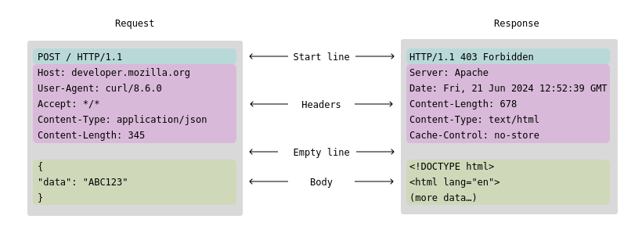
Introduction to APIs
HTTP Messages
illustration taken from https://developer.mozilla.org/en-US/docs/Web/HTTP/Guides/Messages

Slide 20
Introduction to APIs
HTTP Methods
Verbs or Actions that tell the server what action the clients want to perform on the resource.
These actions can vary from retrieval, creation, update, deletion of resources.

Slide 21
Introduction to APIs
HTTP Methods (Common)
GET - the client tells the server to RETRIEVE a resource representation. There is no request body for this request method.
POST - the client tells the server to PROCESS the data. Often used for creation of the resource or entity.
PUT - the client tells the server to UPDATE (or even create) the resource with the provided state based on the targeted entity identifier.
DELETE - the client tells the server to DELETE the entity. The request body is not required (and heavily discouraged from being used) with this method.
PATCH - the client tells the server to perform a PARTIAL UPDATE based on the provided request body

Slide 22
Introduction to APIs
Other HTTP Methods
HEAD - similar to GET but without the response body. Retrieves the headers.
OPTIONS - asks the server what other METHOD can be done on the resource.
TRACE - Echoes the received request back to the client. Commonly used for debugging.
CONNECT - establishes a tunnel to the server.

Slide 23
Introduction to APIs
URL
URL stands for Uniform Resource Locator. URL is a type of URI (Universal Resource Identifier). All URLs are URI but not all URIs are URLs.
It is the complete address of a resource. It’s the mechanism commonly used by browsers to retrieve web pages and other resources.
Given the URL: https://example.com:80/api/a/resource?search=value&sort=asc#AHeaderInTheDocument
Scheme: http
Domain Name: example.com
Port: 80
Path to file: /api/a/resource
Query Parameters: ?search=value&sort=asc
Anchor: #AHeaderInTheDocument

Slide 24
Introduction to APIs
URL - Request Parameters
Query Parameter
URI Parameter / Path Parameter / Route Parameters

Slide 25
Introduction to APIs
URL - Query Parameter
https://example.com:80/api/persons?query=james&sort=asc&size=10&page=0
Query Parameters are appended to a resource path using the symbol “?”. It is used to assign values to specific parameters that may be processed by the API
It is usually used by the client to pass values that can be used for filtering, sorting, searching, and paginating the resource
The example above returns a list of containing the name “James”, paginated with a limit of 10 per page and the first page retrieved in ascending order

Slide 26
Introduction to APIs
URL - URI Parameter
https://example.com:80/api/person/1571/contacts
https://example.com:80/api/person/d8d39df3a47848c2b4c341bceeaa8058/contacts
URI Parameters (sometimes referred to as Route / Path parameters) are parameters that are part of the resource path itself and are usually used to identify which resource to access
URI Parameters can be alphanumeric.
URI Parameters are dynamic values in the implementation of API. In the examples above, the API endpoint would typically look like /person/{personId}/contacts where {personId} is the value passed by the client.
The example above retrieves a Person entity with 1571 as the ID or d8d39df3a47848c2b4c341bceeaa8058 as the UUID.

Slide 27
Introduction to APIs
Headers
Metadata passed with the request. In simple terms, it is data about the data you are sending to the server.
Examples of headers are Authorization and Content-Type metadata which are respectively used to authenticate the user and to tell the server what is the content type of the request (application/json, application/xml, etc.). APIs may use custom headers.

Slide 28
Introduction to APIs
Request Body / Response Body
The data or payload representing an object.
Request Body - the data sent by the client to the server. Typically used in creating a resource, updating a resource, sending any input to the server for processing.
Response Body - the data returned by the server to the client. It contains the requested resource, the result of the request, or errors encountered when processing the request.

Slide 29
Introduction to APIs
Status Code
3-digit code that is sent back with the response. All codes have a specific meaning and provide information on the outcome of the request.
The codes are grouped by their first digit, with each group indicating a different meaning:
1xx: Informational
2xx: Success
3xx: Redirection
4xx: Client Error
5xx: Server Error

Slide 30
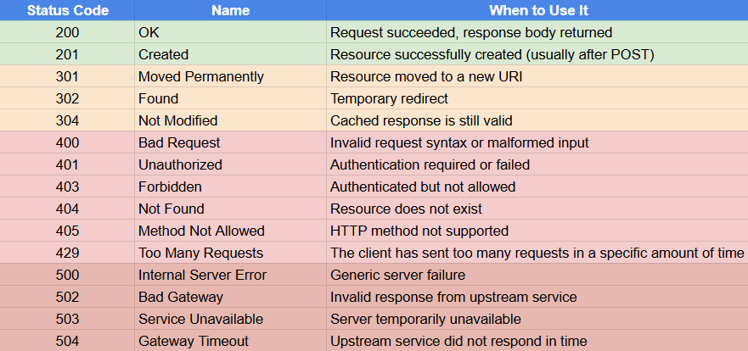
Introduction to APIs
Common Status Codes

Slide 31
Introduction to APIs
JSON
Stands for JavaScript Object Notation
A lightweight format for representing data
Commonly used by Modern RESTful APIs as the payload format
Human-readable, easy for machines to parse, language-agnostic
Derived from JavaScript but not exclusive to JavaScript

Slide 32

Introduction to APIs
JSON - Example
{
“id”: 1517,
“name”: “James”,
“age”: 20
}
On the left is the class definition of Person
On the right is what an instance of a Person would look like in JSON format

Slide 33
Introduction to APIs
JSON Structure
JSON Objects are wrapped in { }
JSON Objects contain key-value pairs
JSON keys are always strings
JSON values can hold other data types such as:
String, Number, Boolean, Null, Object (other JSON objects), Array
JSON Arrays are wrapped in [ ]
JSON Arrays contain an array of values which of any data type supported by JSON

Slide 34
Introduction to APIs
JSON - Example
[
{
“id”: 1517,
“name”: “James”,
“age”: 20,
“favoriteNumbers”: [1, 2, 3, 5]
},
{
“id”: 1519,
“name”: “Mark”,
“age”: 25,
“favoriteNumbers”: [5, 9, 15]
},
{
“id”: 1521,
“name”: “David”,
“age”: 30,
“favoriteNumbers”: [99]
}
]
{
“id”: 1517,
“name”: “James”,
“age”: 20
}
On the left is a single JSON object
On the right is an array of JSON objects

Slide 35
Introduction to APIs
Serialization
The process of converting an object into a stream of bytes so that it can be sent over the network or saved to the database.
Think of it as flattening an object into a simple yet compact format (serializing) and inflating it and reconstructing its exact state for later use (deserializing).
Java objects are commonly serialized/deserialized to/from JSON.

Slide 36
Introduction to APIs
Introduction to Jackson
Jackson is one Java Library commonly used for JSON serialization and JSON deserialization

Slide 37
Introduction to APIs
Importing Jackson via Maven
<dependency>
<groupId>com.fasterxml.jackson.core</groupId>
<artifactId>jackson-core</artifactId>
<version>2.12.4</version>
</dependency>
<!-- The dependencies below are optional -->
<dependency>
<groupId>com.fasterxml.jackson.core</groupId>
<artifactId>jackson-annotations</artifactId>
<version>2.12.4</version>
</dependency>
<dependency>
<groupId>com.fasterxml.jackson.core</groupId>
<artifactId>jackson-databind</artifactId>
<version>2.12.4</version>
</dependency>

Slide 38
Introduction to APIs
Jackson - ObjectMapper
ObjectMapper provides functions to read and write JSON objects (among other functionalities)
ObjectMapper.readValue(String src, Class<T> valueType) is a method for deserializing JSON content from a String into the given Java type (class)
ObjectMapper.writeValueAsString(Object obj) is a method for serializing the given Java object into a JSON String

Slide 39
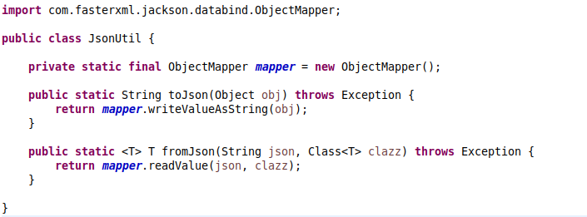
Introduction to APIs
Jackson - ObjectMapper (Example class)

Slide 40
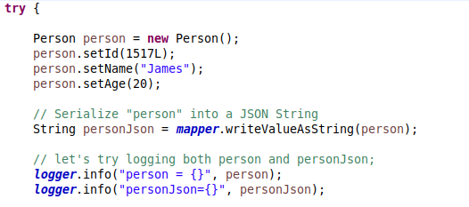
Introduction to APIs
ObjectMapper.writeValueAsString(Object obj)

Slide 41
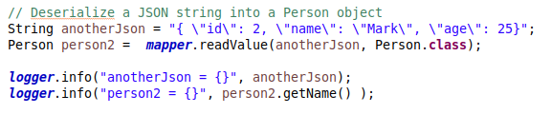
Introduction to APIs
ObjectMapper.readValue(String value, Class<T> clazz)

